Slide 1
COMP1003 - Algorithms, Data Structures and Mathematics Lecture Hashing & Random Numbers
Thomas Wennekers
Plymouth University

Slide 2
Main Ideas
Hash Tables store data from a large/huge search space in a much smaller table, for example, as in a phone book.
Access to the data is through keys that map to the data (ie. names that map to phone numbers)
“hash-functions” can be “random” picking random locations for data given a key
Random Numbers on computers are usually derived from deterministic procedures that only “look” random.

Slide 3
Why is this important ?
Hash-tables are usually very fast which makes them excellent competitors of other ADTs for storage and searching (arrays, lists, trees).
Random numbers are used in many contexts, including gaming, simulation, encryption, ...

Slide 4
Outline
Hashing
Use of Tables
Hash Table Implementation
Random Numbers
Simple/common Implementations

Slide 5
Tables
Two useful sorts of tables
1) lookup table (speed-up of critical calculations)
2) indexed retrieval (e.g., for file systems)
Hash-Tables
Idea
Implementation

Slide 6
1) Look-up Tables
Tables that store data that is expensive to compute
For a function f(n) this could just be the values of the function for all n encountered so far
Look-up tables can be computed off-line, or during program initialisation, or on-the-fly
Re-computation can be avoided in time-critical applications
This may be combined with “hashing” (see later)

Slide 7
2) Indexed Retrieval
Sometimes, an array holding sorted keys falls into
natural “sections”
• For example, if the keys are alphabetic
(e.g., people’s names):
The array starts with some ‘A’ records,
Then some ‘B’ records,
Then some ‘C’ records,
… and so on
→ We can use an index array of start positions

Slide 8
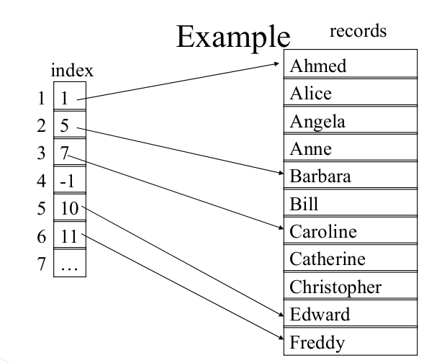
Indexed Retrieval

Slide 9
Retrieval Algorithm
Task: Given a name, find the record in the main array “records” with matching key
Assume the name starts with letter L
Convert L to numeric value V
If index[V] is -1 there are no appropriate records
Otherwise start searching the array “records” from position index[V]
Stop when you’ve found the key, or you’ve found a higher key – In particular one with a different first letter

Slide 10
Indexed Retrieval Efficiency
For a section starting at records[V] we do a linear scan
• Worst case – all the keys start with the same letter
– we do a linear scan through the whole array → O(N)
• Average Case – depends on the average size of a section
– If all sections were quite small it would be quite fast
• Up to 26 times faster than simple linear search
– Some letters are much more common than others; so the gain is probably nearer 10 times faster

Slide 11
We could use a better index …

Slide 12
We could use a better index …
Hashing!

Slide 13
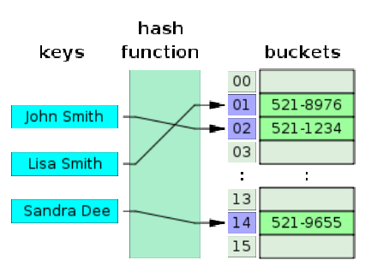
Hash-Table Idea (phone book)
A hash function maps keys (names) into entries in a table (an array). Here data are phone numbers, but this is arbitrary.

Slide 14
Hash-Functions
Hash-functions can be simple !
Characters have numeric values and could be used
Ahmed, Alice, Angela, … – collisions?!
Size of expected data may be important
Hash-Functions should map the range of indexes uniformly
Perfect Hash-Functions map keys uniquely to locations – this is a very seldom situation

Slide 15
Collisions
Collisions happen when two keys map to the same location
Different techniques can be used to resolve this
open addressing
chaining

Slide 16
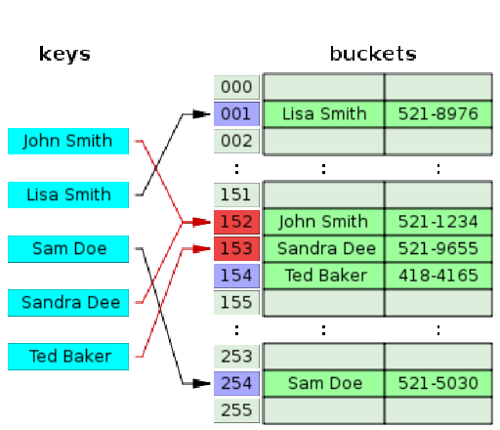
Open Addressing (Shifting)

Slide 17
Open Addressing
Common shift strategies:
linear probing by 1, 2, 3, n elements (cyclically)
quadratic probing: test 0, 1, 4, 9, ...
double hashing; use more than one hash function
→ will later implement linear shifts by 1

Slide 18
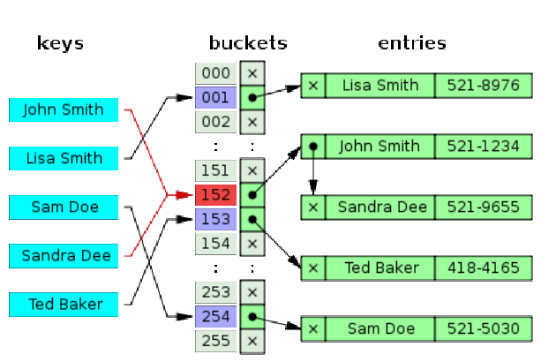
Chaining (using Linked Lists)

Slide 19
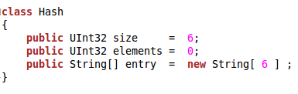
A Hash-Table Implementation (using an array; ignoring collisions)
Note: Instead of just strings, entries would more typically consist of keys (string or int) and complex data types

Slide 20
A Hash-Table Implementation
Possible Methods
Hash Function : key → hash-index
Print hash data
Search hash for an entry given a key
Insert new data into a hash

Slide 21
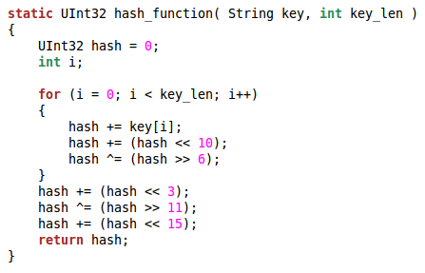
A Hash-Function (from a publicly available Implementation)
The complex bit-shifting of all the key data aims at generating uniform indexes (see later)

Slide 22
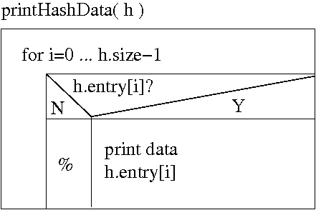
Print the Data in the Hash
Because the Hash uses an Array it can be traversed linearly:

Slide 23
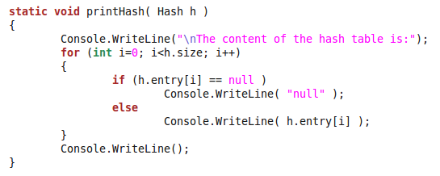
Print Hash Data

Slide 24
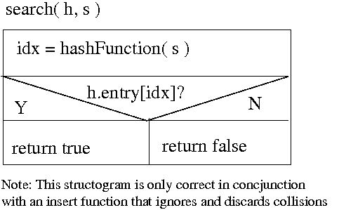
Searching (assuming no collisions)
Note: No loop – we can be quick!!
Note 2: We could also return the data associated with a key

Slide 25
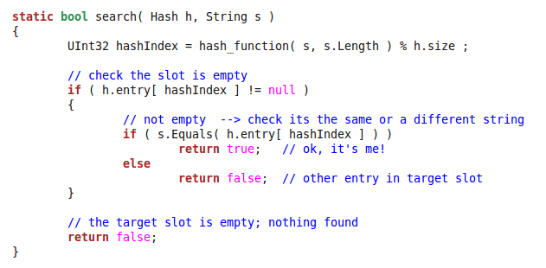
Searching (with checking that the stored data matches)

Slide 26
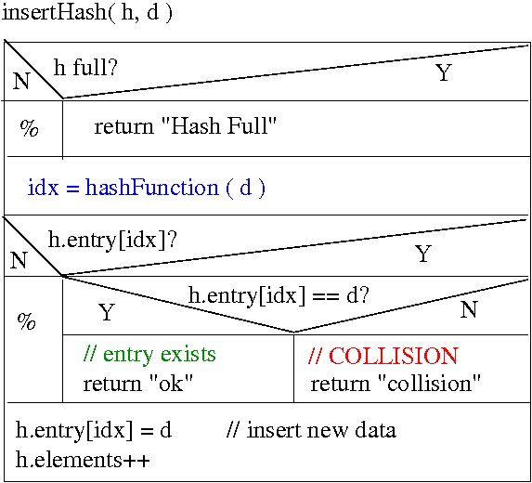
Insert (discarding collisions)

Slide 27
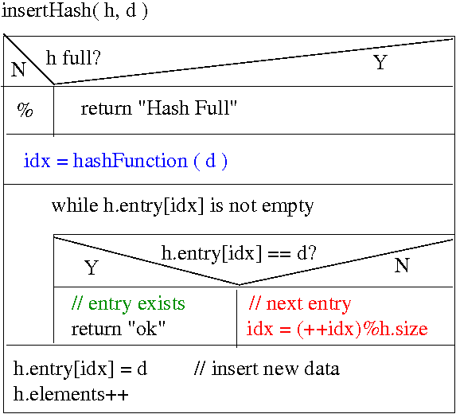
Insert (with collisions using1-shifts)

Slide 28
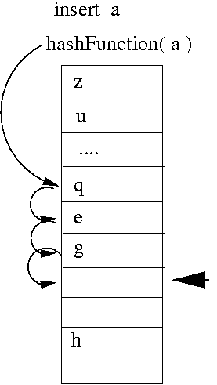
Insert (with collisions; 1-shifts)

Slide 29
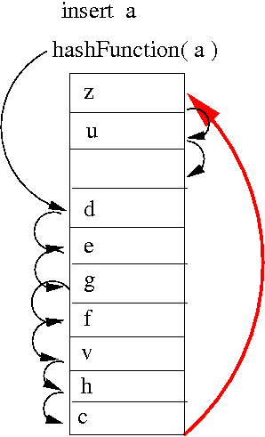
Insert (with collisions; 1-shifts)

Slide 30
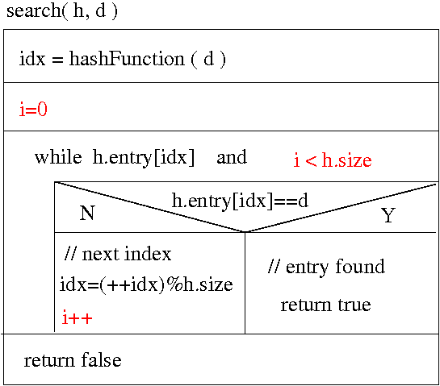
Search with Collisions

Slide 31
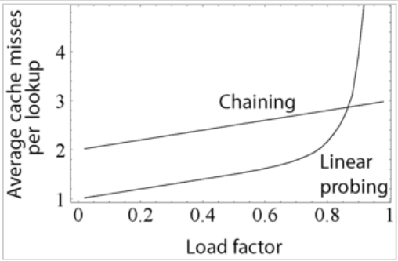
Hash Efficiency (typical)
Very few misses → Almost constant!
Linear shifting becomes inefficient above load 3/4

Slide 32
Hash Efficiency
Hash functions can be quite complex and slower than linear list search for small lists
Memory access is random which leads to bad memory cache alignment
Removing entries is not advised / slow
If the fill factor reaches about .75 resizing hashes is usual (grown or shrunk)
Resizing can be done “on-the-fly” if required; otherwise the hash is “rehashed” into a new larger or smaller array.

Slide 33
Random Numbers

Slide 34
Random Numbers – Ideas
– Randomness reflects “unpredictability”
– 21, 22, 23, 24, 25 .... is predictable
– 17, 53, 65, 12, 0 … is (not?) predictable
– in unpredictable sequences numbers at different positions can take values in a certain range, but these values are independent between different positions

Slide 35
Random Number Generators
– Computers are deterministic machines and can't (usually) generate “true” randomness, only "pseudo-random numbers"
– Random number generators try to generate sequences that look random and are good enough for many applications

Slide 36
Linear Congruential RNGs
Given the previous number they compute the next using a simple equation (predictably!)
r = (a * r + c ) % m
a, c, and m are parameters
the numbers for r must repeat after some cycle
in the best case m is the cycle length
r must be “seeded” with some initial value

Slide 37
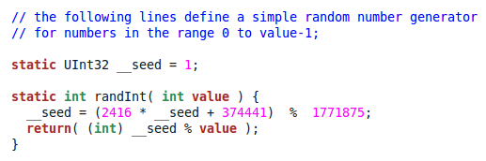
An Implementation
a
c
m
seed grows very quickly and is repeatedly “folded back” into the range 0 … m-1

Slide 38
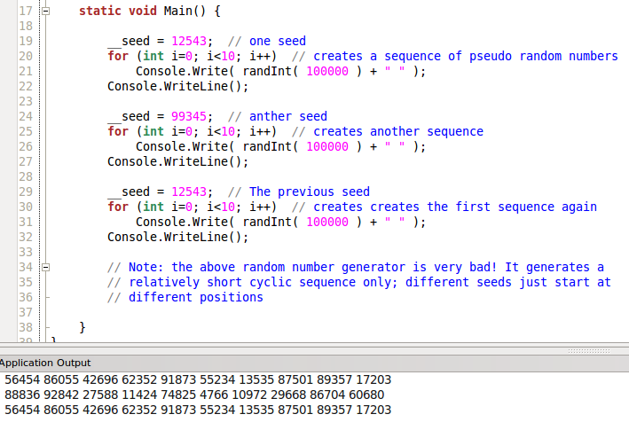
Same seed → same sequence (cf., practical 10)

Slide 39
The sequence is quite short only (cf., practicals)

Slide 40
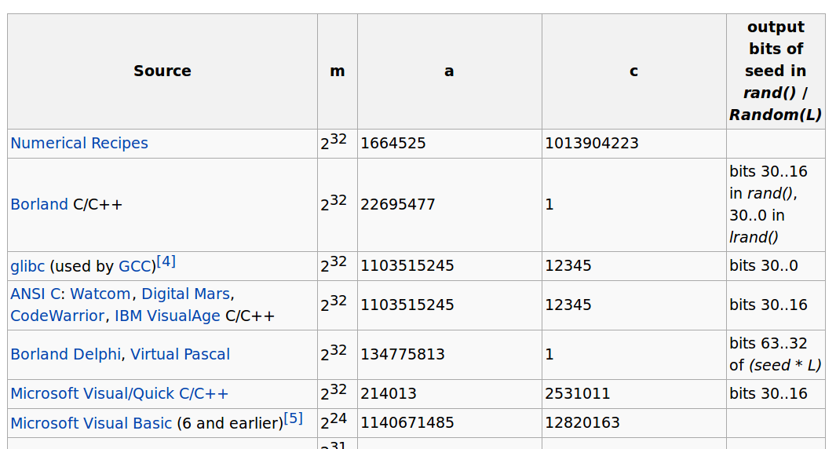
m, a, c in some run-time environments

Slide 41
Outcomes
Hash Table as a very fast search structure
Idea of hash-functions
Basic hash implementation
Idea of pseudo-random number generators
Limitations of RNGs

